Slide 1
Software Design Techniques and Mechanisms
Topic: Creational Design Patterns
Presenter: Drumea Vasile
Chișinău 2021

Slide 2

Overview
The Creational Design Patterns are all about class instantiation.
This group can be divided into 2 groups:
Class-Creation patterns (using inheritance)
Object-Creation patterns (using delegation)

Slide 3
Singleton Pattern
A class that should have only one instance at any time.
It contains static encapsulated instance.
The constructor should be private.
It must be made thread safe.

Slide 4
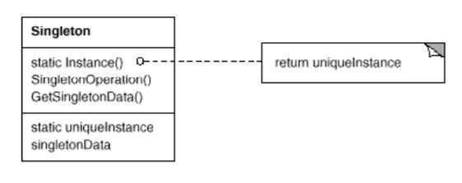
UML Diagram for Singleton

Slide 5
Prototype Pattern
Initialized instances of the classes that are meant to be cloned.
A collection that caches the prototype objects.

Slide 6
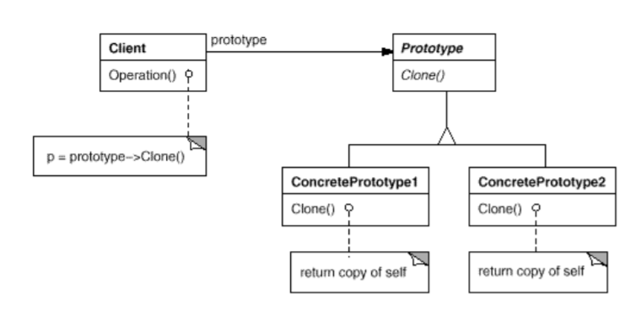
UML Diagram for Prototype

Slide 7
Factory Method Pattern
Creates an instance out of several related derived classes.
It is usually used together with other creational design patterns.

Slide 8
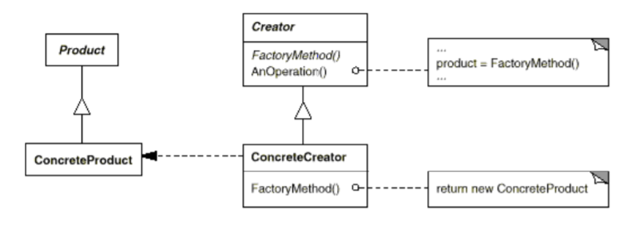
UML Diagram for Factory Method

Slide 9
Abstract Factory Pattern
Provides an interface for creating families of related objects without specifying the concrete object.
It defines Factory Methods for each type of product.

Slide 10
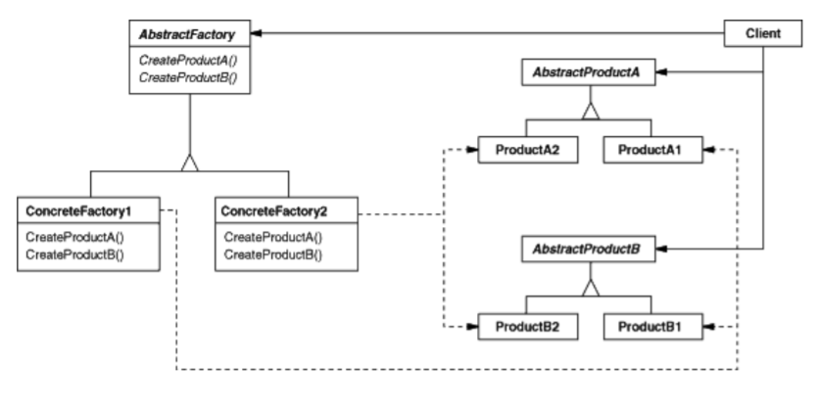
UML Diagram for Abstract Factory

Slide 11
Builder
Separates object construction from its representation so that the same construction process could create different representations.

Slide 12
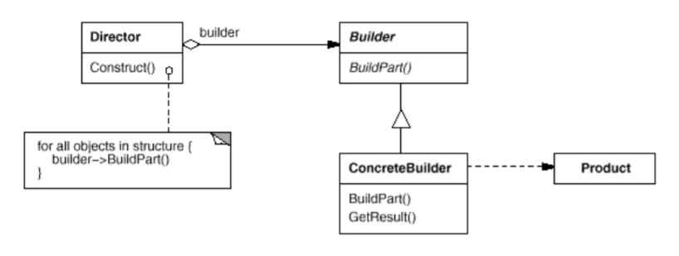
UML Diagram for Builder

Slide 13
References
https://sourcemaking.com/design_patterns/creational_patterns
The “Gang of four”, 1994, Design Patterns: Elements of Reusable Object-Oriented Software
P.S. All the diagrams are from [2].

Slide 14
Thanks for your attention!
Questions?

